Slide 1
MA3077 (DLI) Operational Research Lecture 12 &13– Maximal flows and minimal cuts
Dr Neslihan Suzen

Slide 2
Recap and plan of the day
Summary: in the previous lectures we learnt:
about graphs and networks
how to determine a minimal spanning tree,
how to determine a shortest path tree.
Today: Oriented networks, maximal flows, and minimal cuts, following loosely Ch. 10 of the book by Hillier and Lieberman.

Slide 3
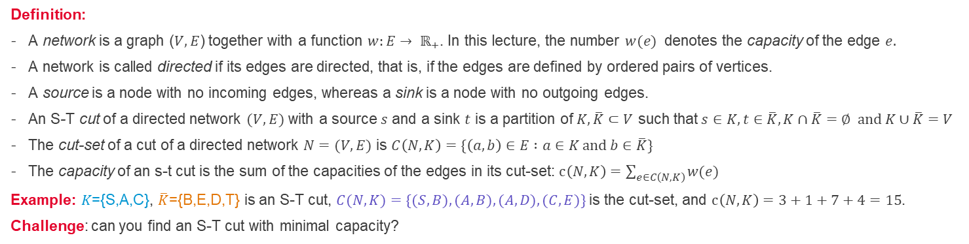
Directed networks - cuts
3
a
1
t
5
4
9
7
b
d
s
2
5
4
1
c
4
e
6
Definition:
A network is a graph ($V,E$) together with a function $w:E→ ℝ_{+}$. In this lecture, the number $w(e)$ denotes the capacity of the edge $e.$
A network is called directed if its edges are directed, that is, if the edges are defined by ordered pairs of vertices.
A source is a node with no incoming edges, whereas a sink is a node with no outgoing edges.
An S-T cut of a directed network $(V,E)$ with a source $s$ and a sink $t$ is a partition of $K, \overline{K}⊂V$ such that$s∈K, t∈\overline{K}, K∩\overline{K}=∅ and K∪\overline{K}=V$
The cut-set of a cut of a directed network $N=(V,E)$ is $C\left(N,K\right)=\{\left(a,b\right)∈E :a∈K and b∈\overline{K}\}$
The capacity of an s-t cut is the sum of the capacities of the edges in its cut-set: $c\left(N,K\right)=\sum_{e∈C\left(N,K\right)}{w(e)}$
Example: 𝐾={S,A,C}, $\overline{K}$={B,E,D,T} is an S-T cut, $C(N,K)=\{(S,B), (A,B), (A,D), (C,E)\}$is the cut-set, and $c\left(N,K\right)=3+1+7+4=15$.
Challenge: can you find an S-T cut with minimal capacity?

Slide 4
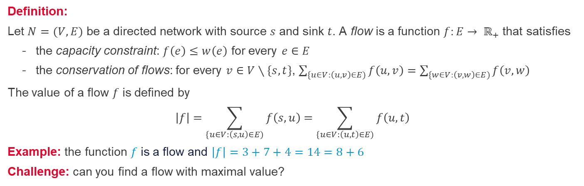
Directed networks - flows
3
a
3
3
1
8
t
5
0
4
4
9
7
7
b
d
s
2
5
1
4
0
3
1
6
4
c
4
4
e
6
Definition:
Let $N=(V,E)$ be a directed network with source $s$ and sink $t$. A flow is a function $f:E→ ℝ_{+}$ that satisfies
the capacity constraint: $f\left(e\right)≤w\left(e\right)$ for every $e∈E$
the conservation of flows: for every $v∈V∖\{s,t\}$, $\sum_{\{u∈V:\left(u,v\right)∈E)}{f\left(u,v\right)}=\sum_{\{w∈V:\left(v,w\right)∈E)}{f\left(v,w\right) }$
The value of a flow $f$is defined by
$$\left|f\right|=\sum_{\{u∈V:\left(s,u\right)∈E)}{f\left(s,u\right)}=\sum_{\{u∈V:\left(u,t\right)∈E)}{f\left(u,t\right)}$$
Example: the function $f$is a flow and $\left|f\right|=3+7+4=14=8+6$
Challenge: can you find a flow with maximal value?

Slide 5
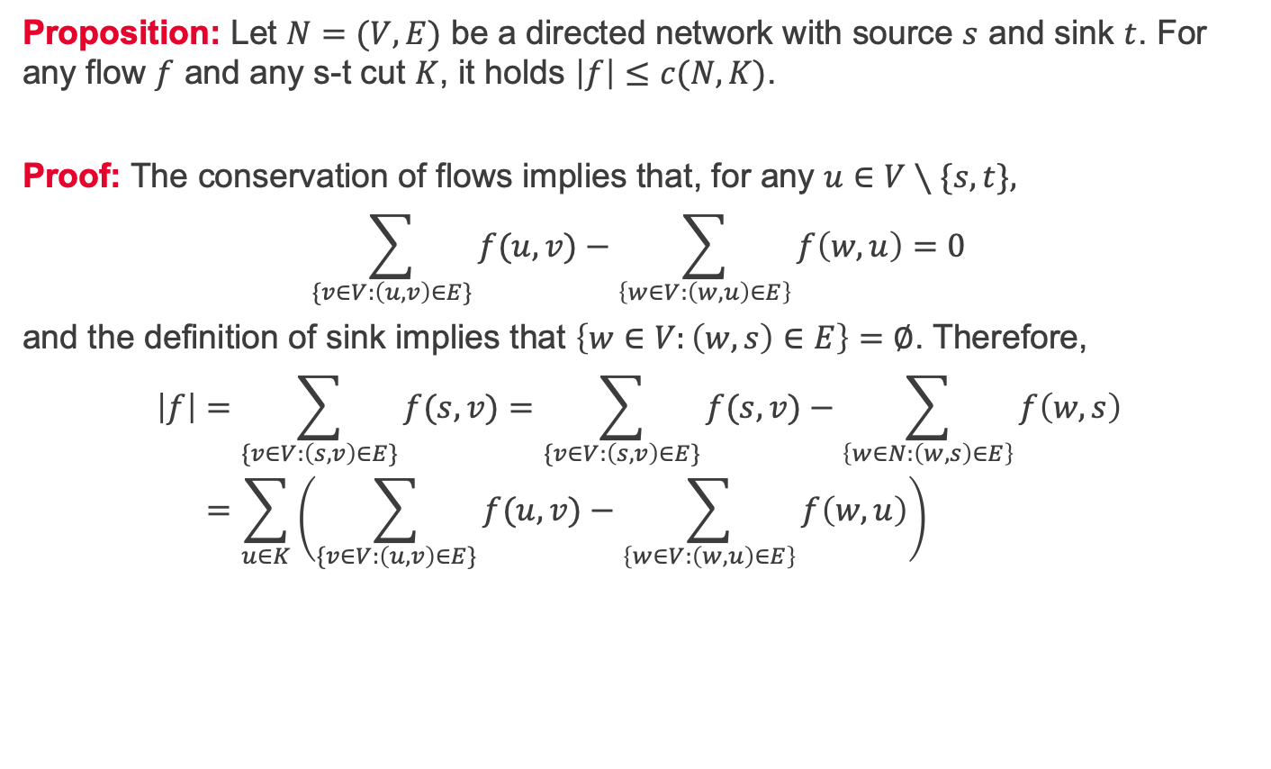
Maximal flows and minimal cuts 1/2
Proposition: Let $N=(V,E)$ be a directed network with source $s$ and sink $t$. For any flow $f$ and any s-t cut $K$, it holds $\left|f\right|≤c(N,K)$.
Proof: The conservation of flows implies that, for any $u∈V∖\{s,t\},$
$$\sum_{\{v∈V:\left(u,v\right)∈E\}}{f(u,v)}−\sum_{\left\{w∈V:\left(w,u\right)∈E\right\}}{f\left(w,u\right)}=0$$
and the definition of sink implies that $\left\{w∈V:\left(w,s\right)∈E\right\}=∅$. Therefore,
$$\left|f\right|=\sum_{\{v∈V:\left(s,v\right)∈E\}}{f(s,v)}=\sum_{\{v∈V:\left(s,v\right)∈E\}}{f(s,v)}−\sum_{\left\{w∈N:\left(w,s\right)∈E\right\}}{f\left(w,s\right)} \\ =\sum_{u∈K}{\left(\sum_{\{v∈V:\left(u,v\right)∈E\}}{f(u,v)}−\sum_{\left\{w∈V:\left(w,u\right)∈E\right\}}{f\left(w,u\right)}\right)}$$

Slide 6
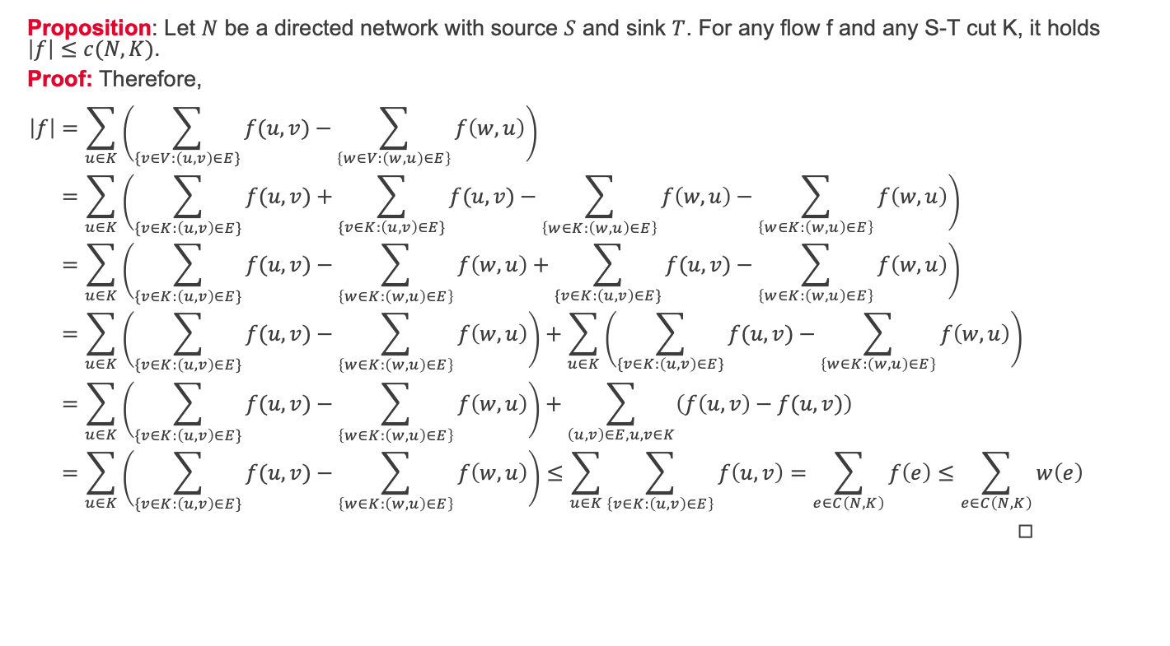
Maximal flows and minimal cuts 2/2
Proposition: Let $N$ be a directed network with source $S$ and sink $T$. For any flow f and any S-T cut K, it holds $\left|f\right|≤c(N,K)$.
Proof: Therefore,
$$\left|f\right|=\sum_{u∈K}{\left(\sum_{\{v∈V:\left(u,v\right)∈E\}}{f(u,v)}−\sum_{\left\{w∈V:\left(w,u\right)∈E\right\}}{f\left(w,u\right)}\right)} \\ =\sum_{u∈K}{\left(\sum_{\{v∈\overline{K}:\left(u,v\right)∈E\}}{f(u,v)}+\sum_{\{v∈K:\left(u,v\right)∈E\}}{f(u,v)}−\sum_{\left\{w∈\overline{K}:\left(w,u\right)∈E\right\}}{f\left(w,u\right)}−\sum_{\left\{w∈K:\left(w,u\right)∈E\right\}}{f\left(w,u\right)}\right)} \\ =\sum_{u∈K}{\left(\sum_{\{v∈\overline{K}:\left(u,v\right)∈E\}}{f(u,v)}−\sum_{\left\{w∈\overline{K}:\left(w,u\right)∈E\right\}}{f\left(w,u\right)}+\sum_{\{v∈K:\left(u,v\right)∈E\}}{f(u,v)}−\sum_{\left\{w∈K:\left(w,u\right)∈E\right\}}{f\left(w,u\right)}\right)} \\ =\sum_{u∈K}{\left(\sum_{\{v∈\overline{K}:\left(u,v\right)∈E\}}{f(u,v)}−\sum_{\left\{w∈\overline{K}:\left(w,u\right)∈E\right\}}{f\left(w,u\right)}\right)+\sum_{u∈K}{\left(\sum_{\{v∈K:\left(u,v\right)∈E\}}{f(u,v)}−\sum_{\left\{w∈K:\left(w,u\right)∈E\right\}}{f\left(w,u\right)}\right)}} \\ =\sum_{u∈K}{\left(\sum_{\{v∈\overline{K}:\left(u,v\right)∈E\}}{f(u,v)}−\sum_{\left\{w∈\overline{K}:\left(w,u\right)∈E\right\}}{f\left(w,u\right)}\right)+\sum_{\left(u,v\right)∈E, u,v∈K}{\left(f\left(u,v\right)−f(u,v)\right)}} \\ =\sum_{u∈K}{\left(\sum_{\{v∈\overline{K}:\left(u,v\right)∈E\}}{f(u,v)}−\sum_{\left\{w∈\overline{K}:\left(w,u\right)∈E\right\}}{f\left(w,u\right)}\right)}≤\sum_{u∈K}{\sum_{\left\{v∈\overline{K}:\left(u,v\right)∈E\right\}}{f\left(u,v\right)}}=\sum_{e∈C\left(N,K\right)}{f\left(e\right)}≤\sum_{e∈C\left(N,K\right)}{w\left(e\right)}=c\left(N,K\right).$$
◻︎

Slide 7
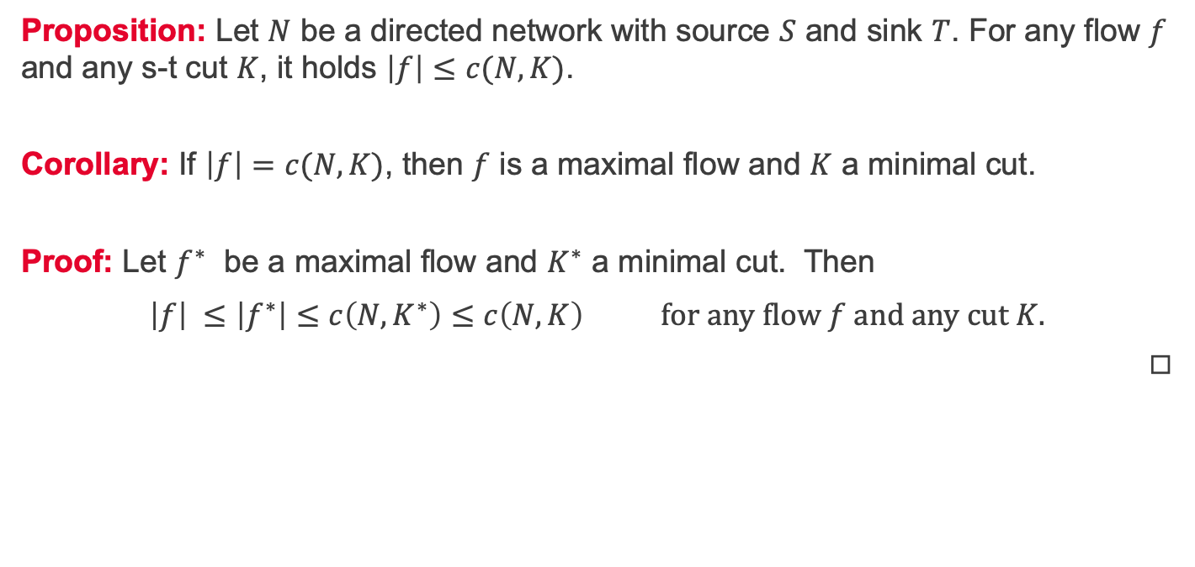
Maximal flows and minimal cuts - corollary
Proposition: Let $N$ be a directed network with source $S$ and sink $T$. For any flow $f$ and any s-t cut $K$, it holds $\left|f\right|≤c(N,K)$.
Corollary: If $\left|f\right|=c(N,K)$, then $f$ is a maximal flow and $K$ a minimal cut.
Proof: Let $f^{∗}$ be a maximal flow and $K^{∗}$ a minimal cut. Then
$\left|f\right| ≤\left|f^{∗}\right|≤c\left({N,K}^{∗}\right)≤c\left(N,K\right) for any flow f and any cut K.$
◻︎

Slide 8
Next lecture

Slide 9
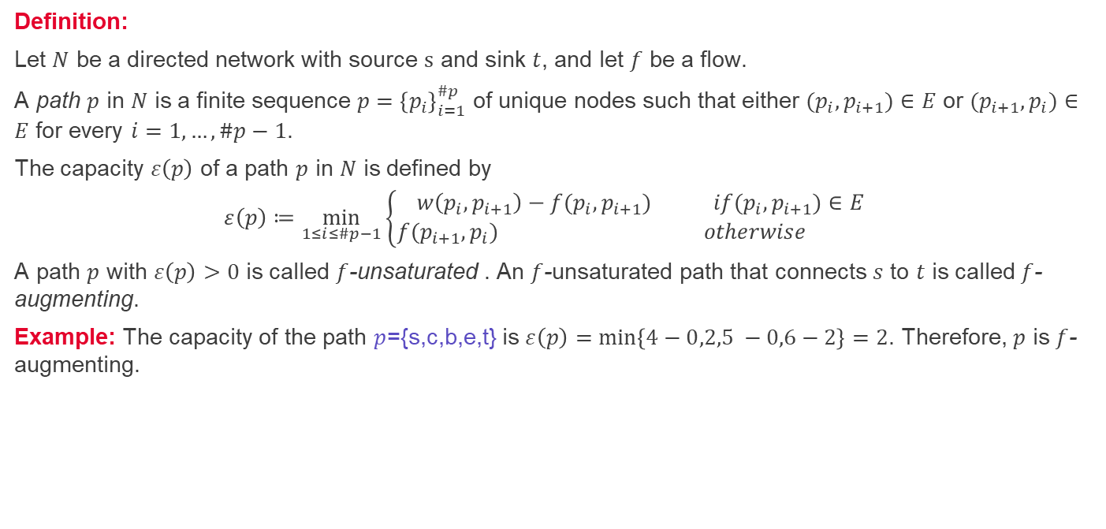
Unsaturated paths
3
a
1
0
t
5
0
4
9
7
0
b
d
4
s
6
2
5
4
4
1
2
0
0
2
0
c
4
e
6
Definition:
Let $N$ be a directed network with source $s$ and sink $t$, and let $f$ be a flow.
A path $p$ in $N$ is a finite sequence $p={\left\{p_{i}\right\}}_{i=1}^{\#p}$ of unique nodes such that either $(p_{i},p_{i+1})∈E$ or $(p_{i+1},p_{i})∈E$ for every $i=1, …, \#p−1$.
The capacity $ε\left(p\right)$ of a path $p$ in $N$ is defined by
$$ε\left(p\right)≔\min_{1≤i≤\#p−1}\left\{\begin{aligned}w\left(p_{i}, p_{i+1}\right)−f{(p}_{i}, p_{i+1}) if{(p}_{i}, p_{i+1})∈E \\ f{(p}_{i+1}, p_{i}) otherwise \end{aligned}\right.$$
A path $p$ with $ε\left(p\right)>0$ is called $f$-unsaturated . An $f$-unsaturated path that connects $s$ to $t$ is called $f$-augmenting.
Example: The capacity of the path $p$={s,c,b,e,t} is $ε\left(p\right)=\min\left\{4−0,2,5 −0,6−2\right\}=2$. Therefore, $p$ is $f$-augmenting.
2

Slide 10
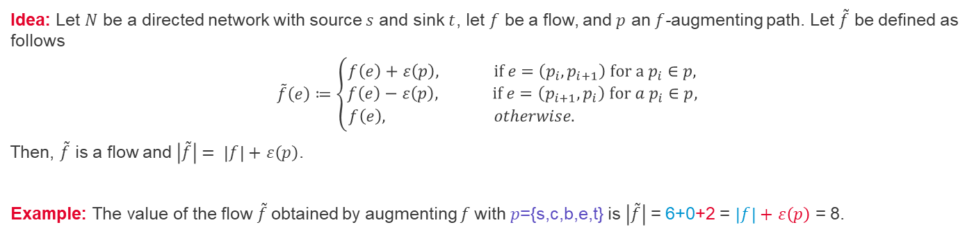
Augmented flows
3
A
0
0
1
4
T
5
0
4
4
9
7
6
B
D
S
2
5
0
4
2-2
1
2+2
0+2
0+2
C
4
2
E
6
Idea: Let $N$ be a directed network with source $s$ and sink $t$, let $f$ be a flow, and $p$ an $f$-augmenting path. Let $\tilde{f}$ be defined as follows
$$\tilde{f}\left(e\right)≔\left\{\begin{aligned}f\left(e\right)+ε\left(p\right), if e=\left(p_{i}, p_{i+1}\right) for a p_{i}∈p, \\ f\left(e\right)−ε\left(p\right), if e=\left(p_{i+1}, p_{i}\right) for a p_{i}∈p, \\ f\left(e\right), otherwise. \end{aligned}\right.$$
Then, $\tilde{f}$ is a flow and $\left|\tilde{f}\right|= \left|f\right|+$ $ε\left(p\right)$.
Example: The value of the flow $\tilde{f}$obtained by augmenting $f$with $p$={s,c,b,e,t} is $\left|\tilde{f}\right|$ = 6+0+2 = $\left|f\right|+$ $ε\left(p\right)$ = 8.

Slide 11
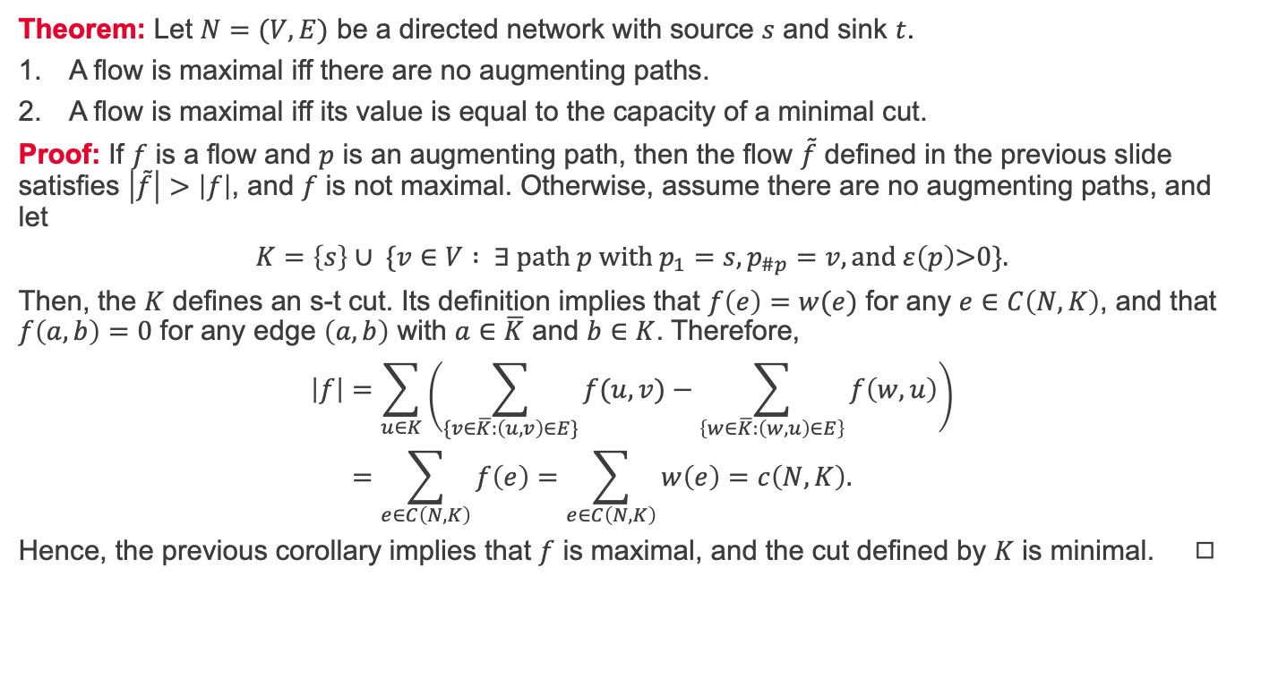
Maximal flows and minimal cuts revisited
Theorem: Let $N=(V,E)$ be a directed network with source $s$ and sink $t$.
A flow is maximal iff there are no augmenting paths.
A flow is maximal iff its value is equal to the capacity of a minimal cut.
Proof: If $f$ is a flow and $p$ is an augmenting path, then the flow $\tilde{f}$ defined in the previous slide satisfies $\left|\tilde{f}\right|>\left|f\right|$, and $f$ is not maximal. Otherwise, assume there are no augmenting paths, and let
$$K=\left\{s\right\}∪ \{v∈V : ∃ path p with p_{1}=s,p_{\#p}=v, and ε\left(p\right)\text{>}\text{0}\text{\}.}$$
Then, the $K$ defines an s-t cut. Its definition implies that $f\left(e\right)=w(e)$ for any $e∈C\left(N,K\right)$, and that $f\left(a,b\right)=0$ for any edge $\left(a,b\right)$ with $a∈$ $\overline{K}$ and $b∈K$. Therefore,
$$\left|f\right|=\sum_{u∈K}{\left(\sum_{\{v∈\overline{K}:\left(u,v\right)∈E\}}{f(u,v)}−\sum_{\left\{w∈\overline{K}:\left(w,u\right)∈E\right\}}{f\left(w,u\right)}\right)} \\ =\sum_{e∈C\left(N,K\right)}{f\left(e\right)}=\sum_{e∈C\left(N,K\right)}{w\left(e\right)}=c\left(N,K\right).$$
Hence, the previous corollary implies that $f$ is maximal, and the cut defined by $K$ is minimal. ◻︎

Slide 12
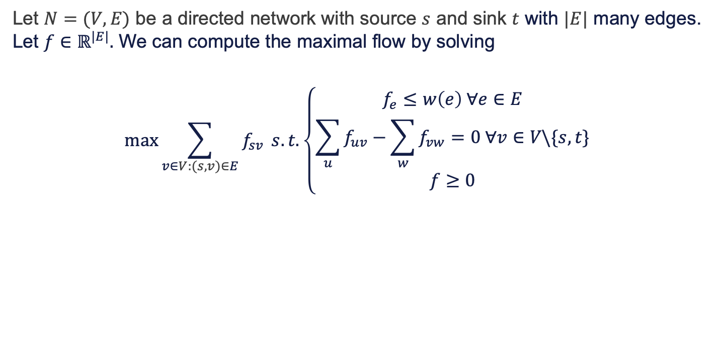
Maximal flow via linear programming
Let $N=(V,E)$ be a directed network with source $s$ and sink $t$ with $|E|$ many edges. Let $f∈ℝ^{|E|}.$ We can compute the maximal flow by solving
$$\max{\sum_{v∈V:(s,v)∈E}{f_{sv}}} s.t.\left\{\begin{aligned}f_{e}≤w\left(e\right) ∀e∈E \\ \sum_{u}{f_{uv}}−\sum_{w}{f_{vw}}=0 ∀v∈V\backslash \{s,t\} \\ f≥0\end{aligned}\right.$$

Slide 13
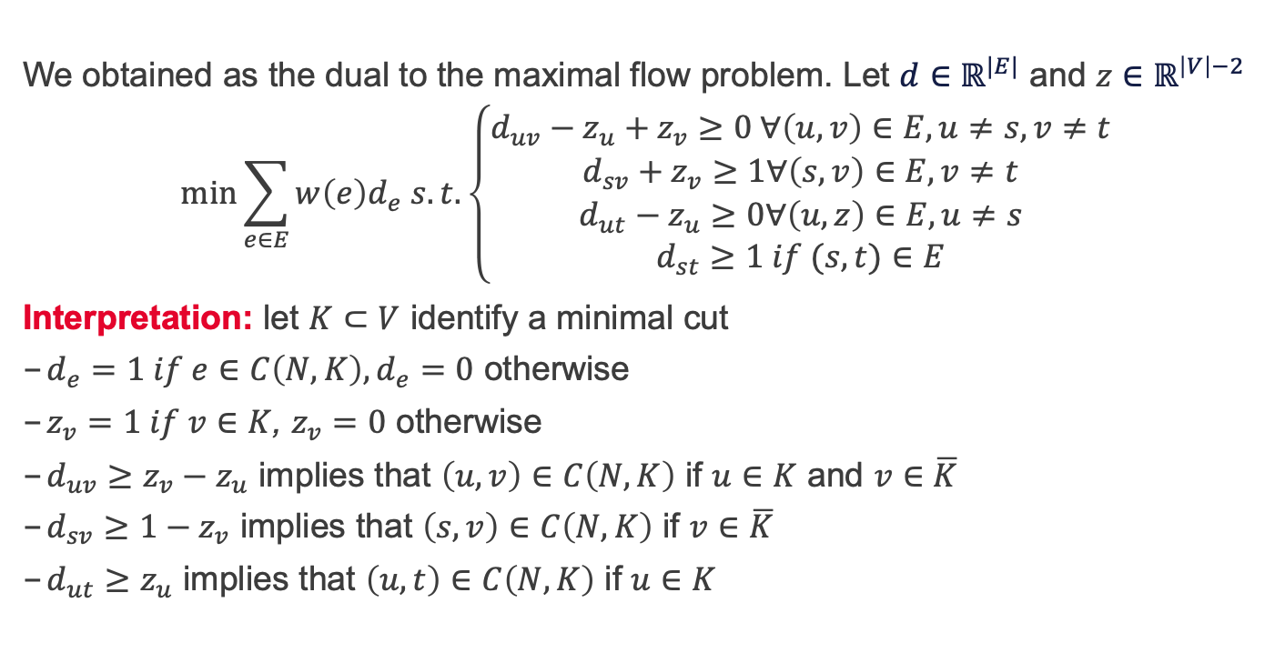
Minimal cut via linear programming
We obtained as the dual to the maximal flow problem. Let $d∈ℝ^{|E|}$ and $z∈ℝ^{\left|V\right|−2}$
$$\min{\sum_{e∈E}{w\left(e\right)d_{e} s. t. \left\{\begin{aligned}d_{uv}−z_{u}+z_{v}≥0 ∀\left(u,v\right)∈E, u≠s, v≠t \\ d_{sv}+z_{v}≥1∀\left(s,v\right)∈E,v≠t \\ d_{ut}−z_{u}≥0∀\left(u,z\right)∈E,u≠s \\ d_{st}≥1 if (s,t)∈E\end{aligned}\right.}}$$
Interpretation: let $K⊂V$ identify a minimal cut
$d_{e}=1 if e∈C\left(N,K\right), d_{e}=0$ otherwise
$z_{v}=1 if v∈K$, $z_{v}=0$ otherwise
$d_{uv}≥z_{v}−z_{u}$ implies that $\left(u,v\right)∈C\left(N,K\right)$ if $u∈K$ and $v∈\overline{K}$
$d_{sv}≥1−z_{v}$ implies that $\left(s,v\right)∈C\left(N,K\right)$ if $v∈\overline{K}$
$d_{ut}≥z_{u}$ implies that $\left(u,t\right)∈C\left(N,K\right)$ if $u∈K$

Slide 14
Maximal flows and minimal cuts in Matlab (see OR13_cutsandflows.m)

Slide 15
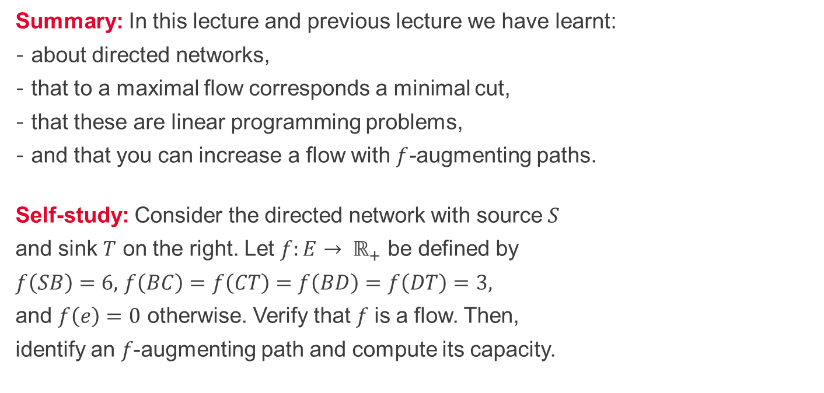
Summary and self-study
Summary: In this lecture and previous lecture we have learnt:
about directed networks,
that to a maximal flow corresponds a minimal cut,
that these are linear programming problems,
and that you can increase a flow with $f$-augmenting paths.
Self-study: Consider the directed network with source $S$
and sink $T$ on the right. Let $f:E→ ℝ_{+}$ be defined by
$f\left(SB\right)=6,$ $f\left(BC\right)=f\left(CT\right)=f\left(BD\right)=f\left(DT\right)=3,$
and $f\left(e\right)=0$ otherwise. Verify that 𝑓 is a flow. Then,
identify an 𝑓-augmenting path and compute its capacity.

